Slide 1
AI for Business Decisions
How Artificial Intelligence and Decision Theory is used for Decision Support in business environments

Slide 2
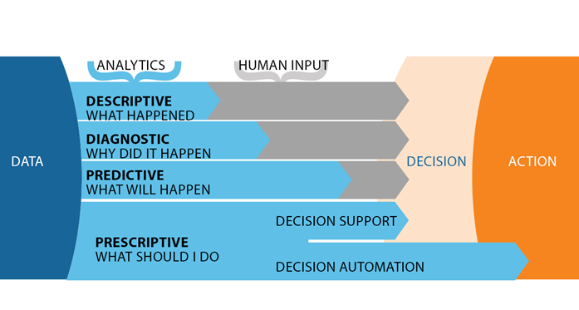
AI Background
The goal of artificial intelligence is to design rational agents that take the best actions given the information available, their prior knowledge, and their goals.
In many cases, the information and knowledge is incomplete or unreliable, and the results of their decisions are not certain, that is, they have to make decisions under uncertainty.
Decision Theory provides a framework for decision making under uncertainty. Artificial intelligence researchers interested in understanding and building intelligent agents use this.
Agents using these technologies could be both machines, as well as human decision makers, in which case the agent implements a Decision Support System
Traditional analytics does not support decision making, leaving business users unable to connect insights into actions
Prescriptive analytics/AI to the rescue!
“For years, predictive analytics has dominated the spotlight for analytics, overshadowing prescriptive analytics. However, that is starting to change. Today, adoption for prescriptive analytics is at an all-time high, with Gartner predicting that the market will reach $1.1 billion by 2019.”

Slide 3

AI Background
The goal of artificial intelligence is to design rational agents that take the best actions given the information available, their prior knowledge, and their goals.
In many cases, the information and knowledge is incomplete or unreliable, and the results of their decisions are not certain, that is, they have to make decisions under uncertainty.
Decision Theory provides a normative framework for decision making under uncertainty. It was initially developed in economics and operations research, but in recent years has attracted the attention of artificial intelligence researchers interested in understanding and building intelligent agents.
Agents using these technologies could be both machines, as well as human decision makers, in which case the agent implements a Decision Support System

Slide 4
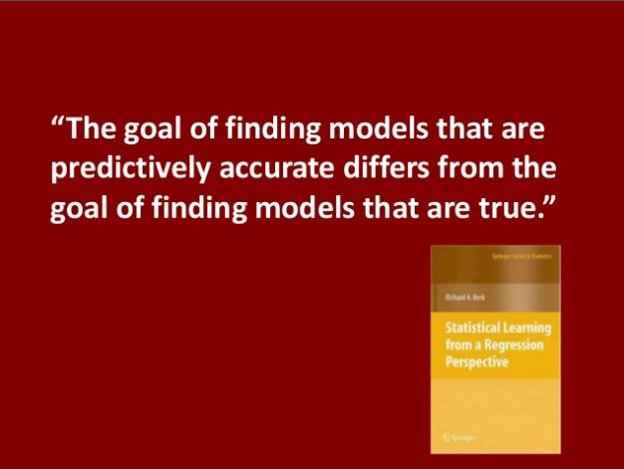
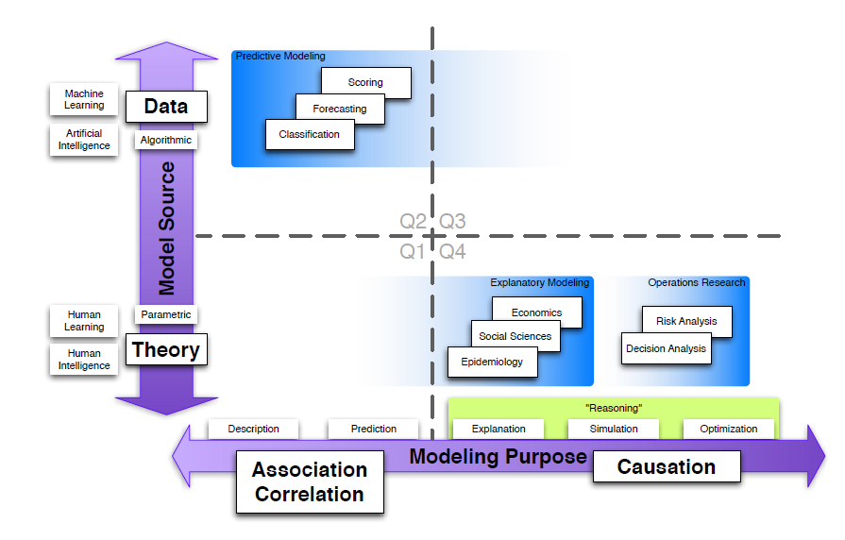

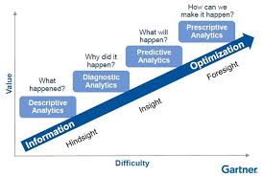
Analytics Background
Source: BaysiaLab
Source: To Explain and Predict (http://www.galitshmueli.com/content/explain-or-predict)
Some issues that are not well understood in Analytics community:
Not a simple relationship between Analytical solutions (Gartner fail?!)
Predictive and Explanatory models are inherently different, and
Causation is central to actionable insights

Slide 5


Synthesis
y$= F(x,θ)$
Explain (Why?)
Predict (What?)
AI
Deep Learning
Causal inference
Machine Learning
Domain knowledge
Strategic
Automation
Interaction with Decision Makers
Value Prop
Good (expensive) Tools
Good (expensive) Consultants

Slide 6
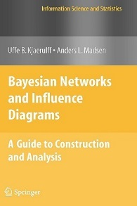
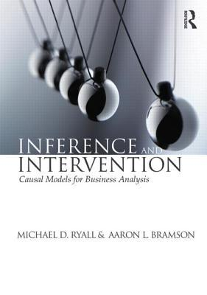
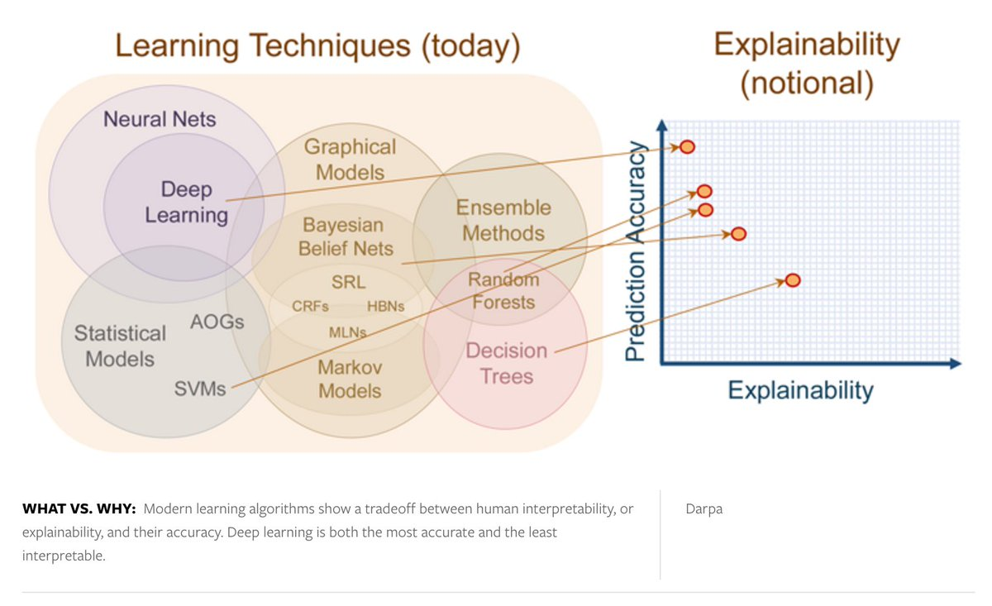
Call to action (“waiting for XAI”…)
Graphical Models are today’s solution to handle requirements of Prescriptive Analytics, including Causal Inference
Knowledge solicitation enables SME experience and data to be merged into one coherent model.
Integrated with “Success Science” (OR, Management Science, Decision Analysis, etc.) into Decision Networks generates a powerful solution
Enables opportunity to “climb value chain” into strategic solutions, closing the human decision gap
Source: DARPA on Explainable AI (XAI)

